Slide 1

PROPOSED TITLE
Face Recognition-Based Attendance System Using open cv And Python To Improve Accuracy And Efficiency
GUIDE
STUDENTS
Dr. S. Senthilvadivu
Dr.T. Kumaragurubaran
Professor
Department of CSE
Saveetha School of Engineering
K.V.CHARAN TEJA-192424167
R.UDAY KUMAR REDDY-192424190
A.VIKRANTH REDDY-192424193
Saveetha School of Engineering

Slide 2


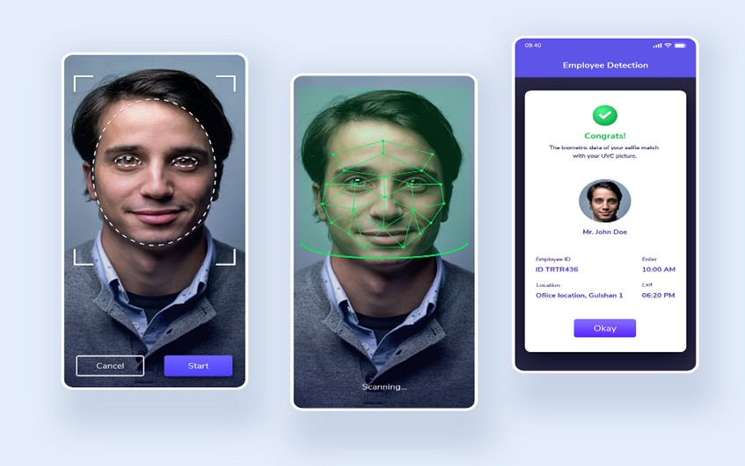
INTRODUCTON
Face recognition technology offers a contactless and automated way to record attendance.
Using cameras and Python, these systems can significantly reduce manual effort and errors.
The goal is to improve both accuracy and efficiency in attendance management processes.

Slide 3
Proposed Objectives
To develop an automated attendance system that records attendance using real-time face recognition instead of manual methods.
To implement accurate face detection and recognition using OpenCV algorithms such as Haar Cascade and LBPH.
To create and manage a facial image dataset for training the recognition model efficiently.
To reduce proxy attendance and human errors by ensuring identity verification through biometric recognition.
To generate and maintain digital attendance records with date and time for easy monitoring and reporting

Slide 4
LITERATURE REVIEW
Paper Title | Author(s) | Major Findings | Year
Face Recognition-Based Attendance System Using OpenCV | R. Sharma, P. Gupta | Implemented OpenCV face recognition to automate attendance marking and reduce manual effort. | 2022
Automated Attendance Management Using Face Detection | S. Verma, K. Singh | Proposed real-time face detection system that improved attendance accuracy. | 2023
Smart Attendance System Using LBPH Algorithm | A. Kumar, N. Patel | Used LBPH algorithm for fast and reliable face recognition in classrooms. | 2023
Deep Learning-Based Face Recognition for Attendance | M. Reddy, S. Rao | Applied CNN models to enhance recognition accuracy under lighting variations. | 2024
AI-Powered Face Recognition Attendance System | V. Mehta, R. Jain | Integrated AI recognition with database storage for secure attendance tracking. | 2025

Slide 5
Methodology
1. Data Collection:
Capture multiple face images of users using a webcam.
2. Image Preprocessing:
Convert images to grayscale, resize, and remove noise.
3. Model Training:
Train the LBPH face recognition model using labeled datasets.
4. Face Detection & Recognition:
Detect faces with Haar Cascade and recognize in real time.
5. Attendance & Report Generation:
Automatically mark attendance with date and time and generate reports.

Slide 6
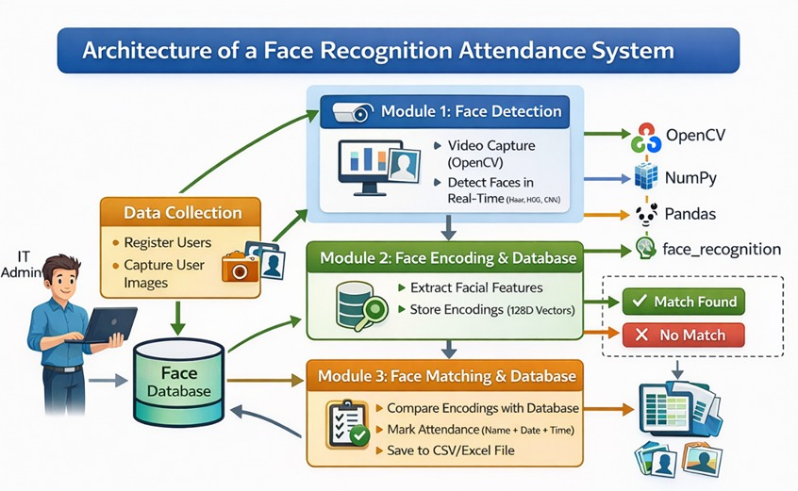
Architecture diagram

Slide 7
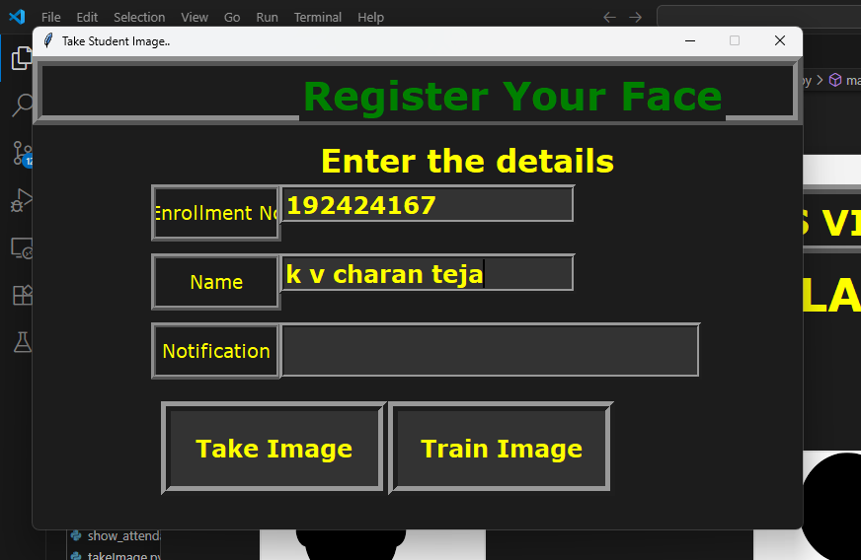
MODULES
Module 1 — Face Data Acquisition & Dataset Management
Collects and stores user face images and personal details.
Creates and manages face dataset for recognition.
Allows updating and maintaining user records.
Ensures secure storage of user data.
Captures multiple face samples to improve accuracy.

Slide 8
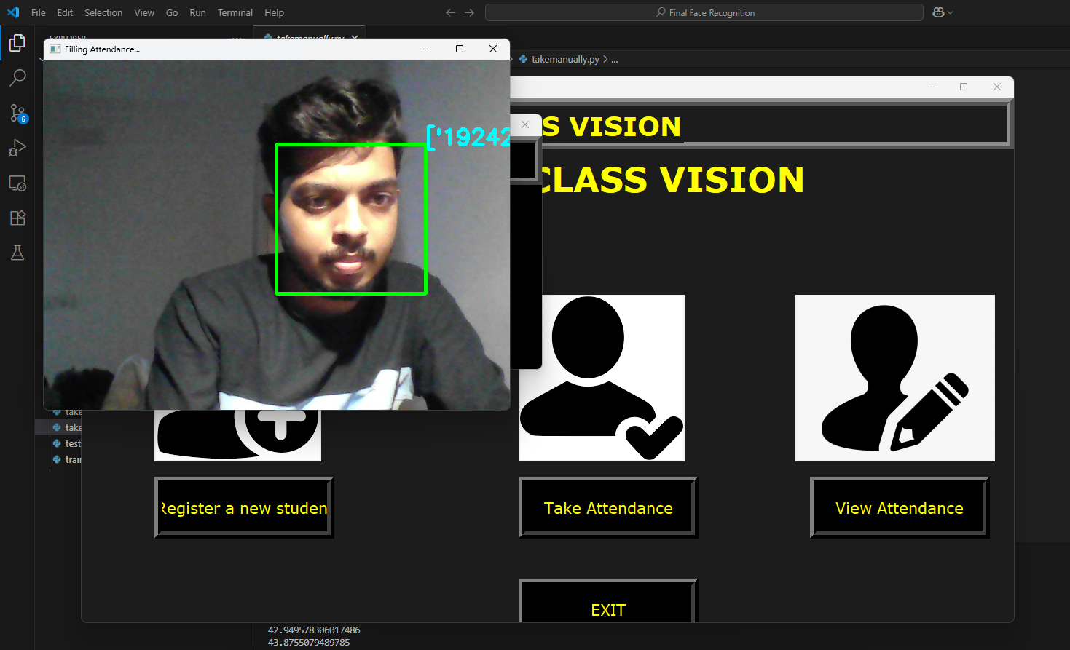
Module 2 — Face Detection & Recognition Engine
Captures live video and detects faces using camera.
Extracts facial features and compares with database.
Identifies registered users in real time.
Sends recognition result to attendance module.
Works under different lighting and angles.

Slide 9
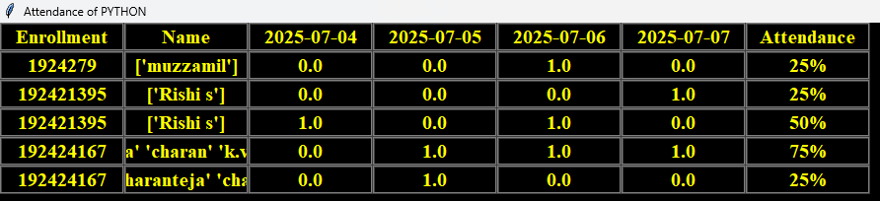
Module 3: Automated Attendance Marking and Report Generation
Marks attendance automatically after face recognition.
Stores attendance with date and time.
Generates attendance reports for monitoring.
Prevents duplicate attendance marking.
Helps administrators track attendance easily.

Slide 10
Results And Discussions
Accurate Face Recognition:
The system successfully recognized registered users with high accuracy under normal lighting conditions.
Automated Attendance Marking:
Attendance was recorded automatically with Name, ID, Date, and Time, eliminating manual work.
Real-Time Performance:
Face detection and recognition were performed in real time using a webcam.
Error & Duplicate Reduction:
Proxy attendance and duplicate entries were prevented, improving data reliability.
System Limitations & Improvements:
Accuracy decreased under poor lighting or occlusion; performance can be enhanced using deep

Slide 11
Challenges & Limitations
Lighting Variations:
Recognition accuracy decreases in poor or uneven lighting conditions, affecting face detection quality.
Pose and Angle Differences:
Faces not aligned to the camera or captured at extreme angles may not be recognized correctly.
Occlusion Issues:
Masks, glasses, caps, or facial obstructions reduce recognition performance.
Dataset Dependency:
System accuracy highly depends on the number and quality of training images.

Slide 12
Future Scope
Liveness Detection Implementation:
Add anti-spoofing techniques such as blink detection or 3D face verification to prevent fake attendance using photos/videos.
Mask Face Recognition:
Enhance the system to recognize faces even when users wear masks or partial coverings.
Cloud Database Integration:
Store attendance data on cloud platforms for centralized access, backup, and multi-location monitoring.
Mobile App Connectivity:
Develop a mobile application for real-time attendance tracking, notifications, and report viewing.

Slide 13
Conclusion
Automated Attendance Achieved:
The system successfully replaces manual attendance with an automated face recognition process.
High Recognition Accuracy:
Using OpenCV and LBPH algorithm, the system provides reliable and real-time face identification.
Time and Effort Reduction:
Attendance marking becomes faster, reducing paperwork and administrative workload.
Error and Proxy Prevention:
Biometric verification minimizes duplicate entries and proxy attendance issues.
Scalable and Practical Solution:
The system can be enhanced with advanced AI techniques and deployed in institutions or organizations.

Slide 14
References
Sharma, R., & Gupta, P. (2022). Face Recognition-Based Attendance System Using OpenCV. International Journal of Computer Vision and Image Processing.
Verma, S., & Singh, K. (2023). Automated Attendance Management System Using Face Detection. International Journal of Advanced Research in Computer Science.
Kumar, A., & Patel, N. (2023). Smart Attendance System Using LBPH Face Recognition Algorithm. IEEE International Conference on Artificial Intelligence and Smart Systems.
Reddy, M., & Rao, S. (2024). Deep Learning-Based Face Recognition for Smart Attendance Systems. Journal of Machine Learning Applications..

